Slide 1

React
Hooks & Fetch

Slide 2
# Table of Contents
Hooks: State and Effect
Fetch
Refactor

Slide 3
Hooks

Slide 4
# Hooks
New addition in React 16.8
Function that let you “hook into” state and lifecycle from Function Component.
Use React feature (state & lifecycle) without Class Component.
Not work inside Class.
Referensi: React - Introducing Hooks.

Slide 5
# Rules
Only call Hooks at the top level
Don’t call inside loops, conditions, or nested functions
Only call Hooks from Function Component.
Don’t call from regular functions.
Don’t call from Class Component.
Referensi: React - Rules of Hooks.

Slide 6
# Built-in Hooks
State Hook: useState
Effect Hook: useEffect
Context Hook: useContext
Reducer Hook: useReducer
Custom Hook
Referensi: React - Hooks API.

Slide 7
State Hook

Slide 8
# State
Private data in Component.
Special variable in React.
Encapsulated: Live inside Component.
Re-rendered Component when state changes.

Slide 9
# State vs Variable
Variable: If variable changes, Component is not re-rendered.
State: If state changes, Component is re-rendered.
Variable and State can used together, depending on needs.
Referensi: React - Using State Hook.

Slide 10
# State Hook
Add state to Function Component.
State Hook: useState().
Referensi: React - Using State Hook.

Slide 11
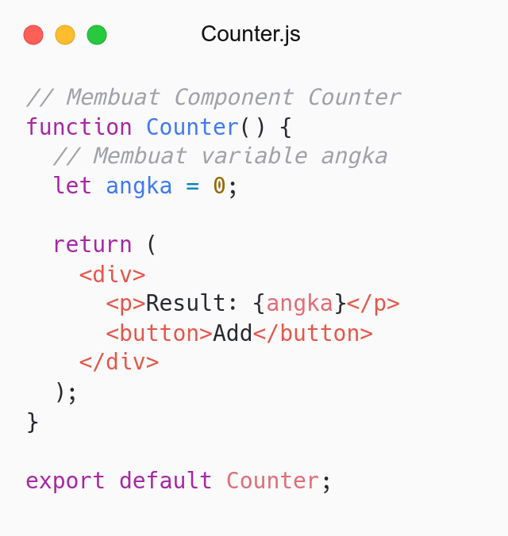

Slide 12
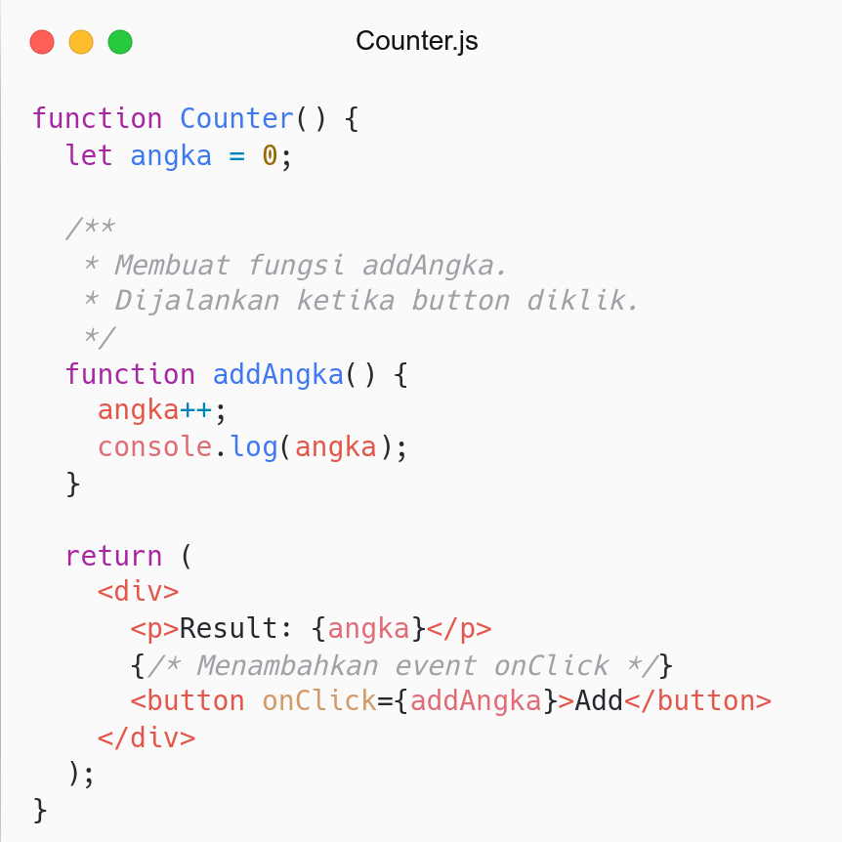
Apakah angka bertambah di console dan <Counter />?
Bagaimana angka di <Counter /> bertambah?
Solution: Convert variable to state.

Slide 13
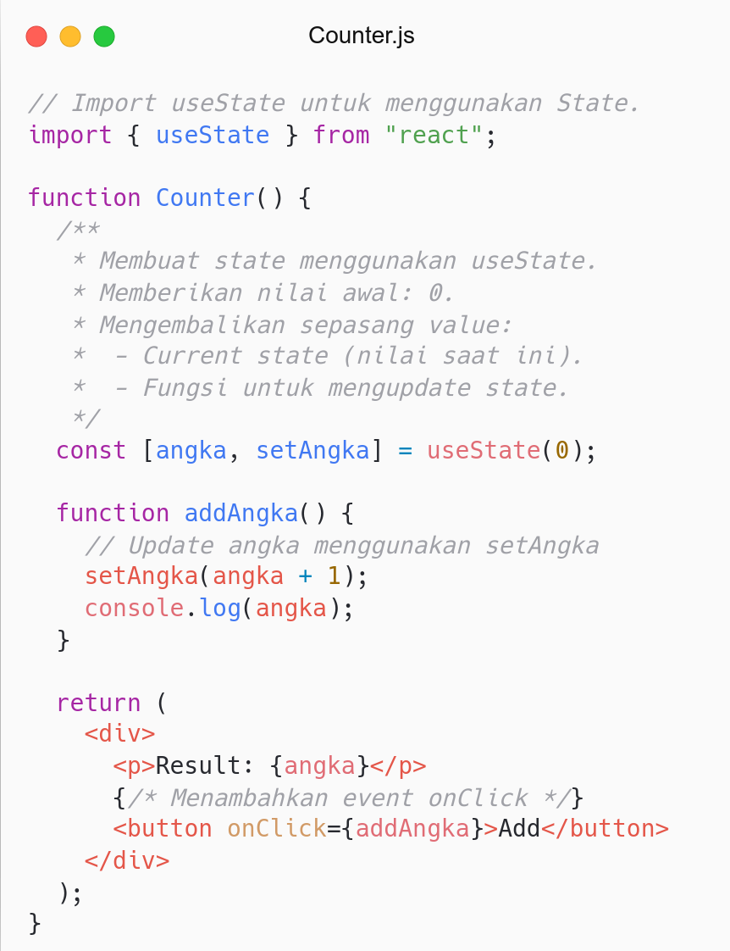
import useState.
Buat state menggunakan useState dan set nilai awal.
useState mengembalikan sepasang value (array):
Current state (value).
Function untuk update state.
Lakukan destructing untuk mengambil hasil useState.

Slide 14
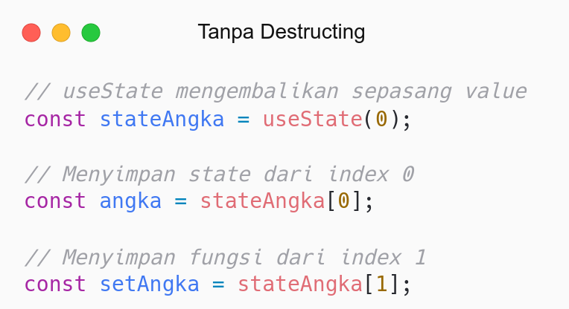
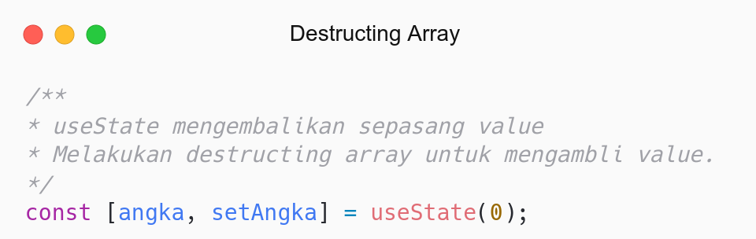

Slide 15
Effect Hook

Slide 16
# Lifecycle
Siklus hidup yang terjadi pada React Component.
Render: Membuat Component (belum ditampilkan ke DOM).
Dapat berjalan berkali-kali (jika state berubah).
Mounting: Inserting Component into DOM.
Hanya berjalan sekali pada saat di-insert ke DOM.
Updating: Updating Component into DOM.
Dapat berjalan berkali-kali (jika state berubah).
Unmounting: Removing Component from DOM.
Hanya berjalan sekali pada saat dihapus dari DOM.

Slide 17
# Effect Hook
Perform side effects.
Side effects: Perform other jobs besides render Component.
Example: Access DOM, Fetch, Subscription.

Slide 18
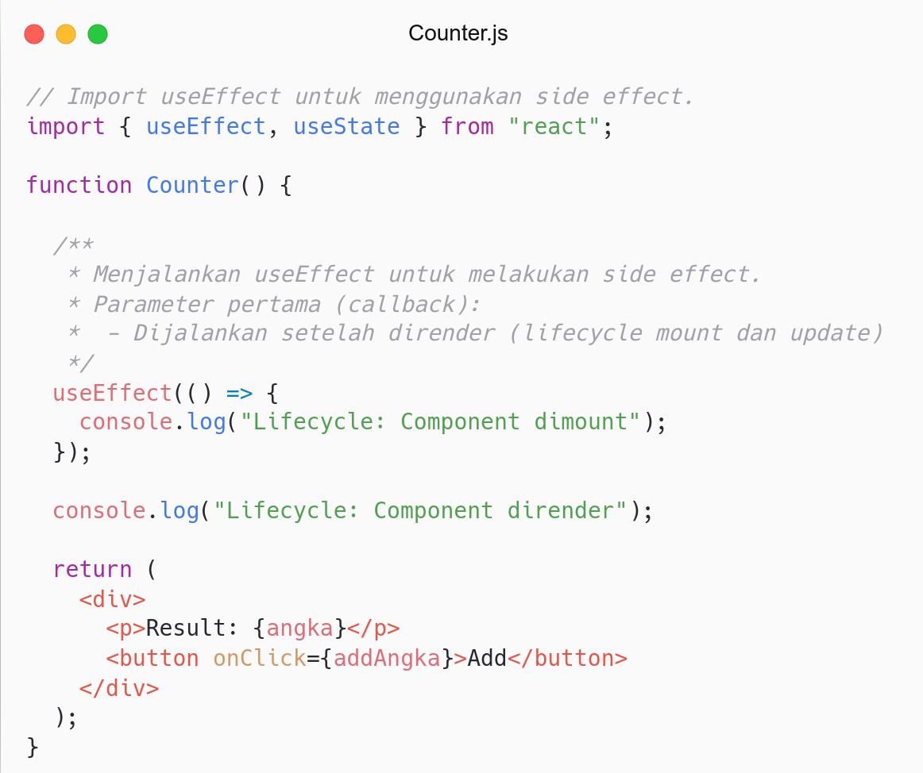
Effect berjalan berkali-kali.
Effect berjalan pada lifecycle mount dan update.
Effect pertama dijalankan untuk lifecycle mount.
Effect selanjutnya dijalankan untuk lifecycle update.

Slide 19
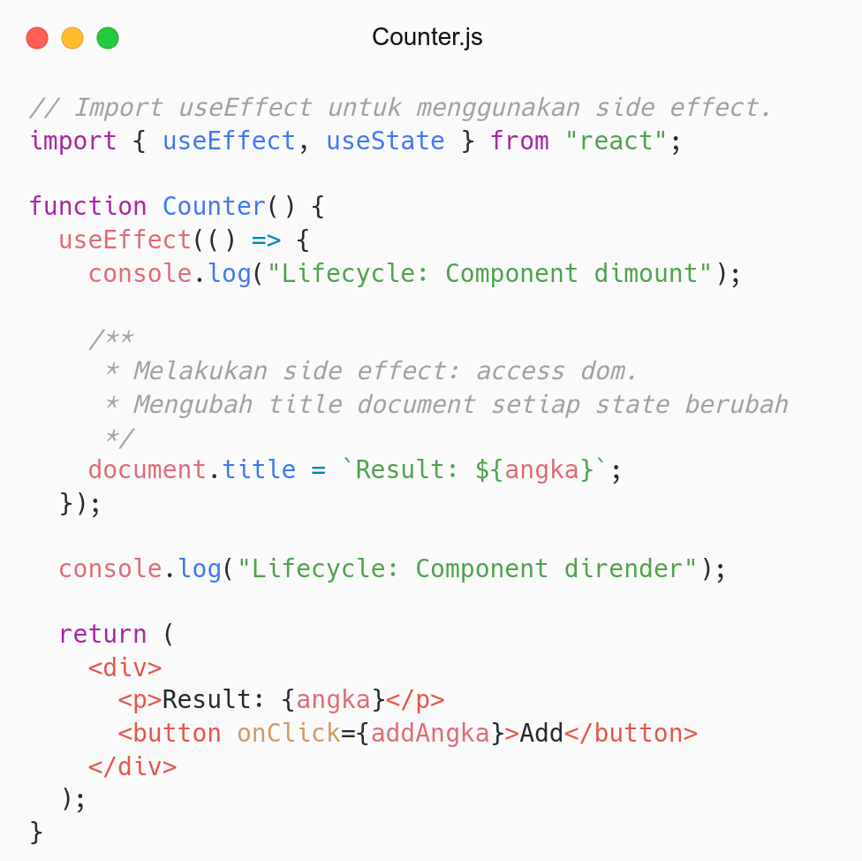
Side effect: Melakukan tugas lain selain render Component.
Tugas: Akses DOM title.

Slide 20
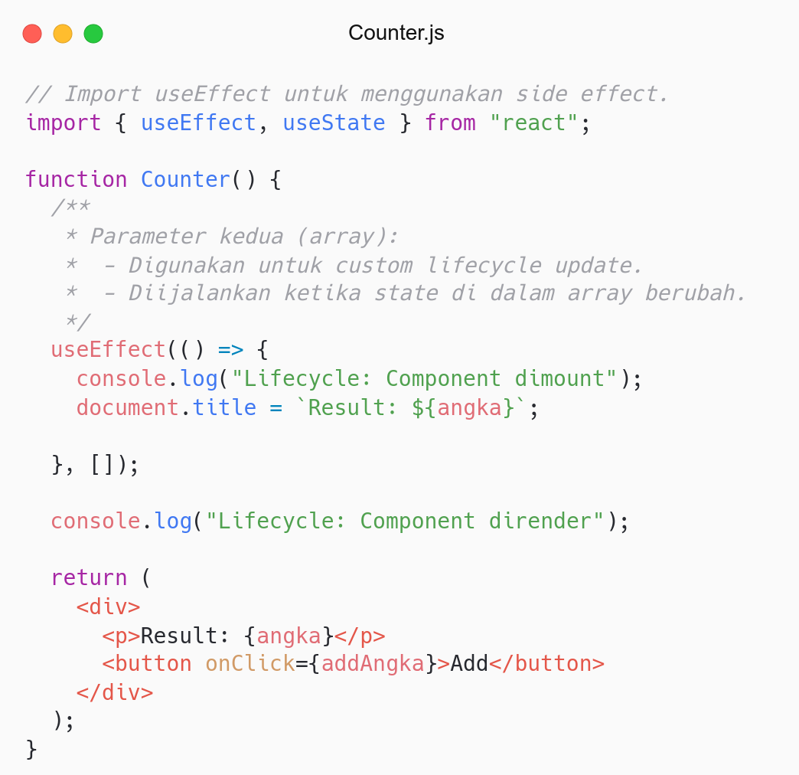
Bagaimana membatasi Effect pada lifecycle update?
In some cases might create performance problem.
Solution: Second param (array).

Slide 21
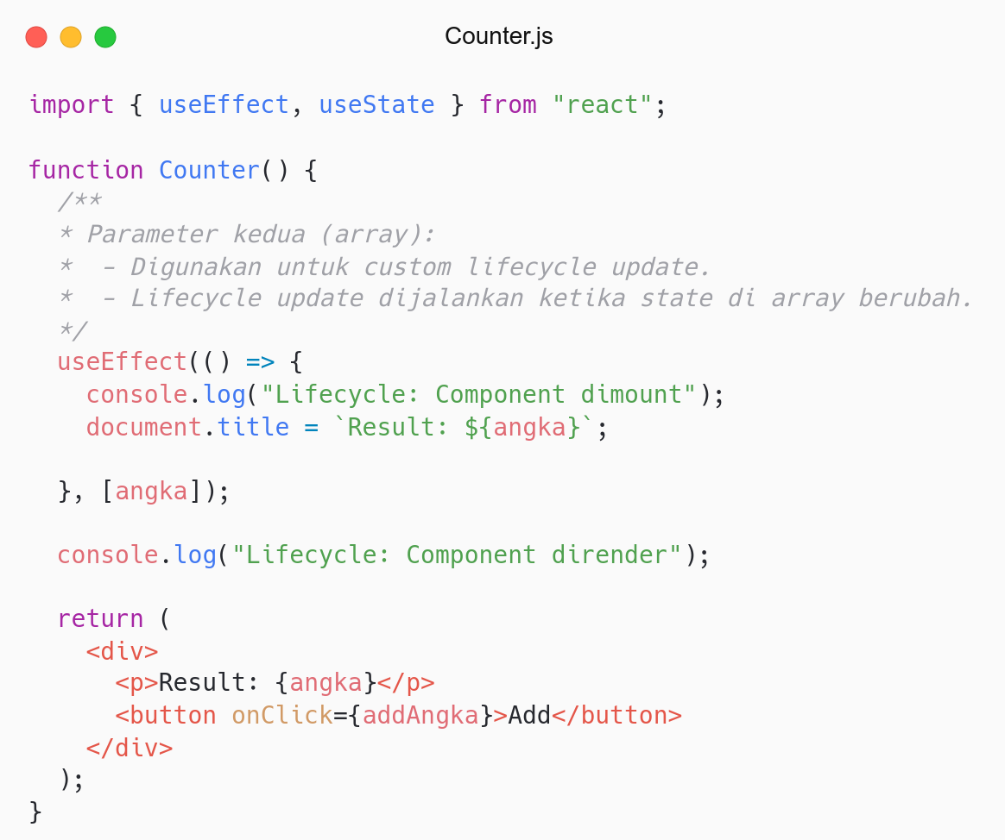
Bagaimana menjalankan Effect ketika state berubah (update)?
Solution: Gunakan state di second param.
Jika state di array berubah, maka jalankan Effect lagi (update).

Slide 22
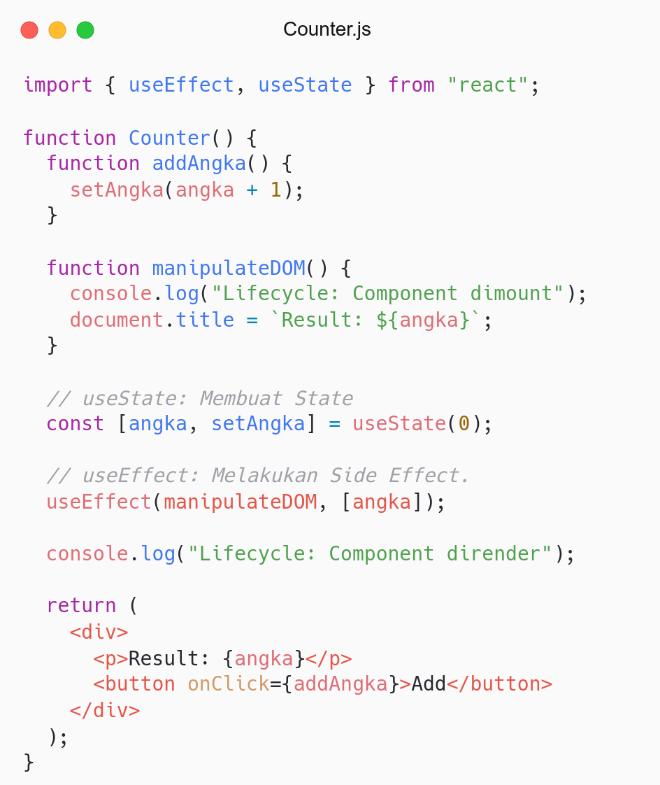
Refactor:
Refactor effect to be independent function.
Recap:
State hook to create state.
Effect hook to perform side effect.
Effect run after render (mount and update)
Second params used to custom lifecycle update.

Slide 23
Let’s do another side effect
Fetch + Hooks (State & Effect)

Slide 24
Fetch

Slide 25
# Fetch
Modern API to make request to the server.
Similar to AJAX (XHR).
Promise-based.
OMDB API:
URL: https://www.omdbapi.com/?apikey=fcf50ae6&i=tt2975590
API Key: fcf50ae6
ID Film Superman: tt2975590

Slide 26
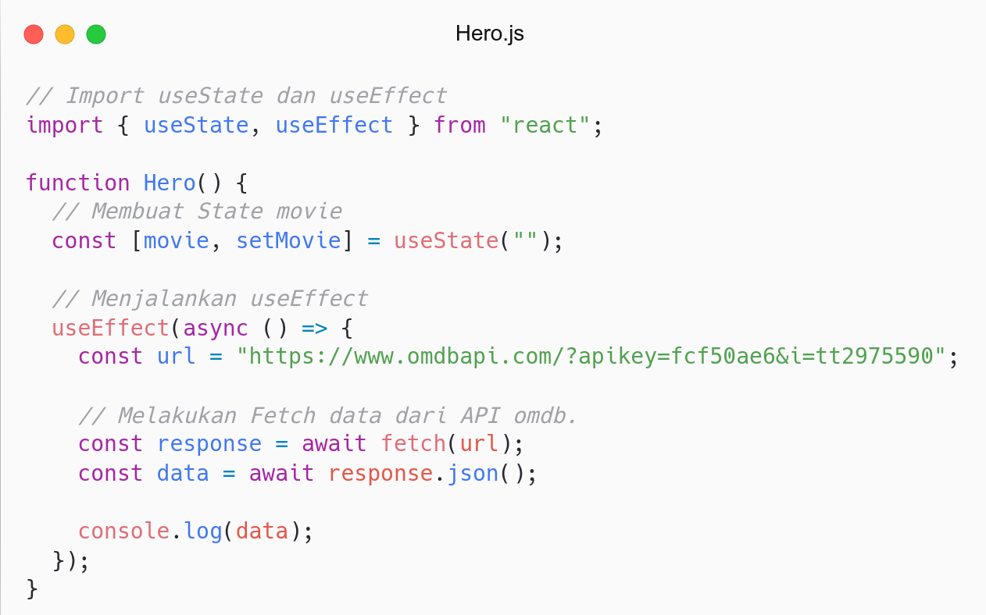
Melakukan side effect (Fetch):
Membuat state movie.
Menjalankan useEffect
Melakukan Fetch

Slide 27
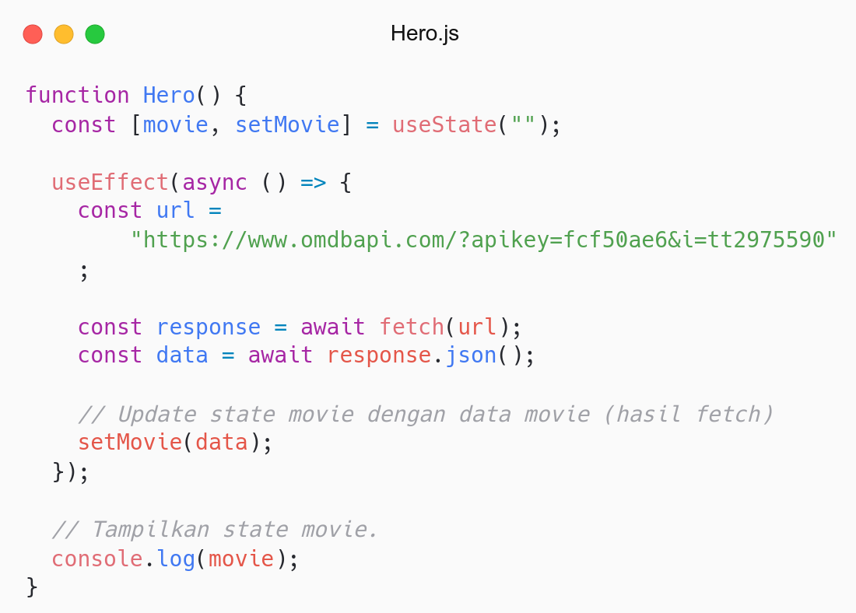
See the console.
Kenapa useEffect (fetch) berjalan berkali-kali?
Masih ingat lifecycle update?
Ketika state berubah, maka useEffect dijalankan lagi (update).
Solution: Second param (array).

Slide 28
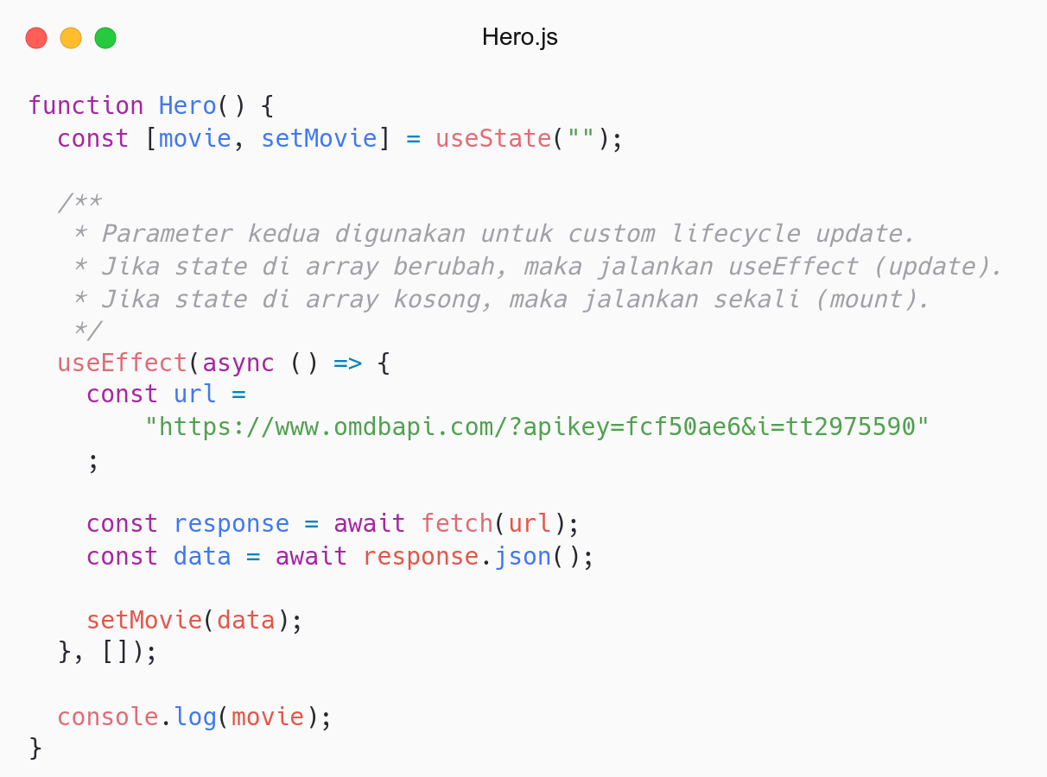
Second param digunakan untuk custom lifecycle update.
Effect dijalankan lagi ketika state di array berubah.
Jadi, jika kosong maka Effect hanya berjalan sekali (mount).

Slide 29
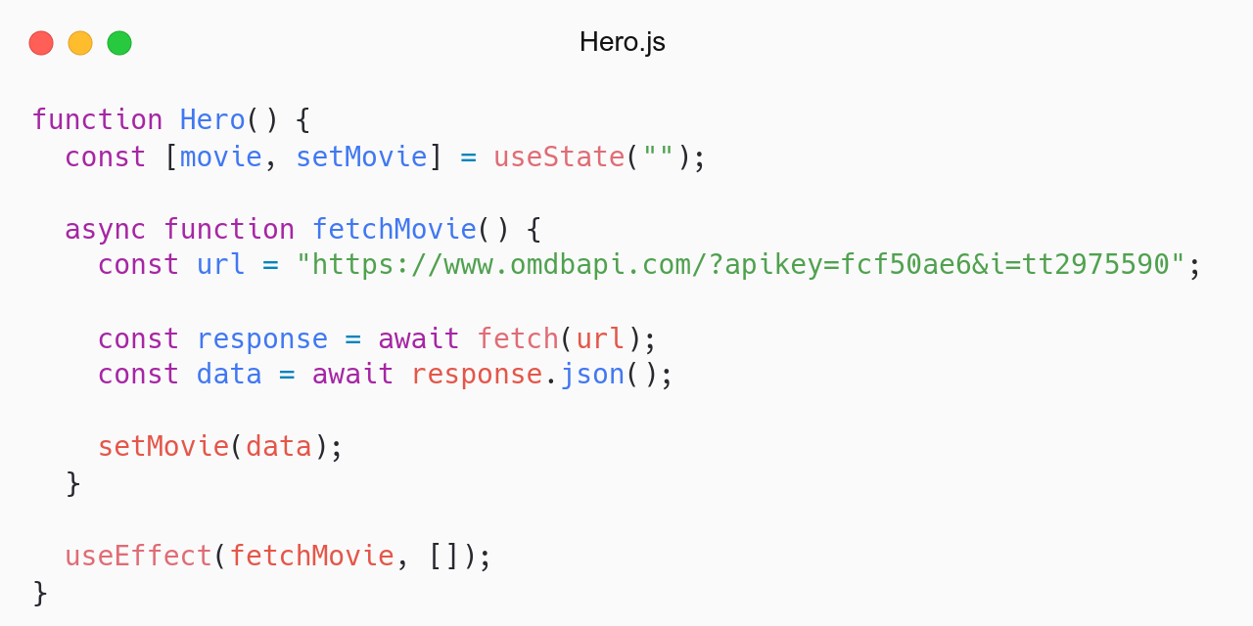
Refactor.
Membuat fungsi fetchMovie.
Clean code.

Slide 30
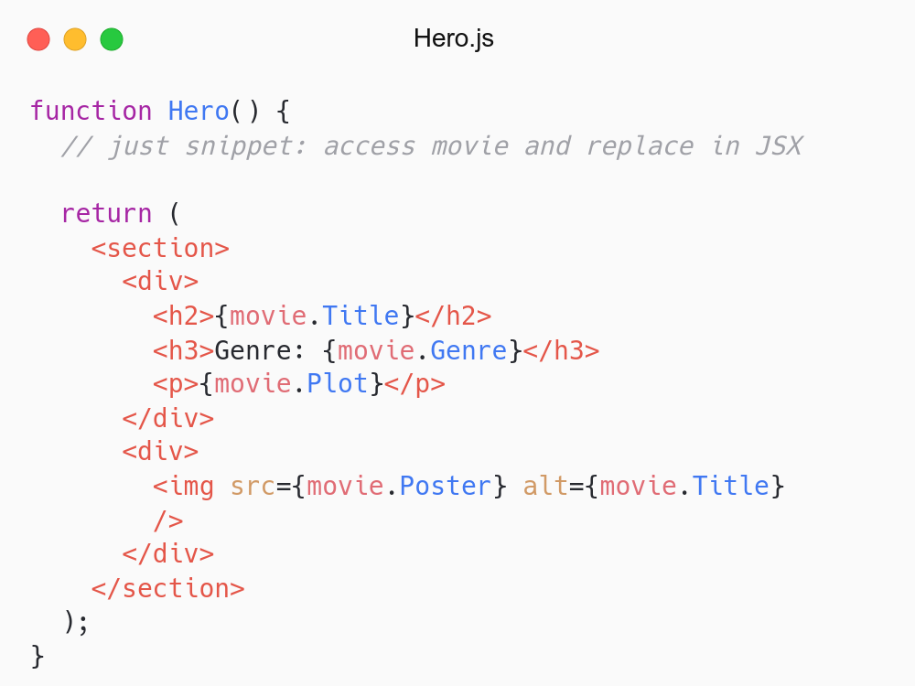
Update <Hero />.
Access movie (state) in JSX.

Slide 31
Refactor

Slide 32
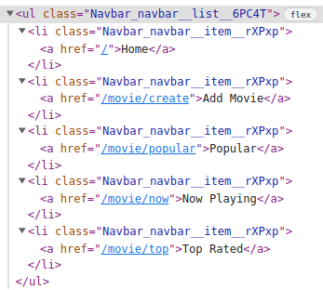

How to fix <Link />?
<Link /> rendered as <a />

Slide 33
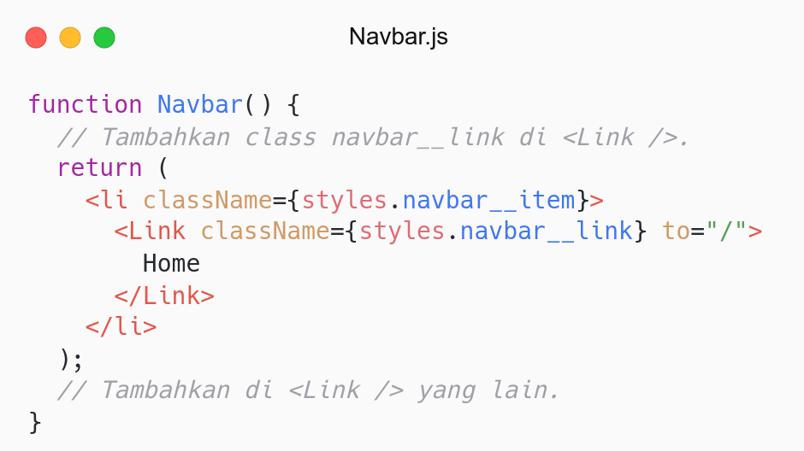
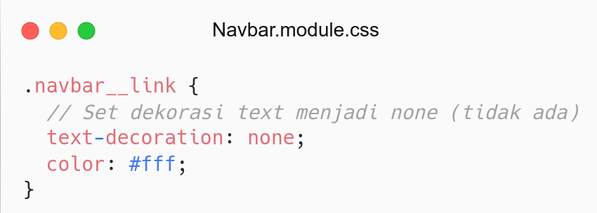

Slide 34
QnA

Slide 35
Take Away

Slide 36
# TODO
Push your work to Github.

Slide 37
# Assignment
Push code to Repository Github (use branch for task management).
No zip and don’t push node_nodules folder.
Submit link repository to elena.
Kamis: 27 April 2022, Link Elena.
Jumat: 29 April 2022, Link Elena.

Slide 38
Attendance

Slide 39
Thanks

